Slide 1






Slide 2
Content
Overview of the Problem
Preprocessing
Feature Engineering
Fitting the Model

Slide 3

Overview of the Problem
Logistics services must receive an order and have it delivered within the shortest time to appease their users.
Accurate Prediction of Delivery Time helps with :
Customer experience and satisfaction.
In addition, the solution will enable service providers to realise cost savings, and ultimately reduce the cost of doing business, through improved resource management and planning for order scheduling.

Slide 4
Overview of the Problem
Challenge
Predict the estimated time of arrival for orders- from pick-up to drop-off.
Background
Logistics in Sub-Saharan Africa increases the cost of manufactured goods by up to 320%.

Slide 5
Problem Statement
The goal is to train a regression model which will take data about a good delivery order as input and then output the estimated time of delivery of order, from the point of driver pickup to the point of arrival at final destination to improve efficiency of deliveries

Slide 6
Preprocessing
Data Summary
 | TRAIN DATASET | TEST DATASET
Features | 29 | 25
Number of Data Points | 21201 | 7068

Slide 7
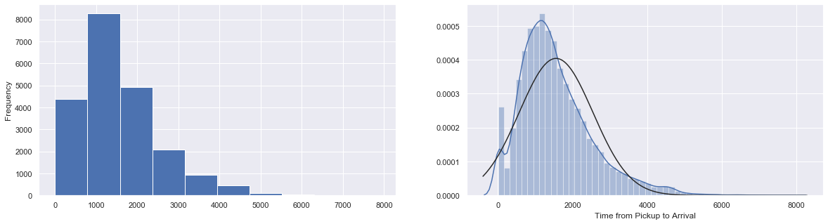
Distribution of the Target Variable
Target Variable Distribution

Slide 8
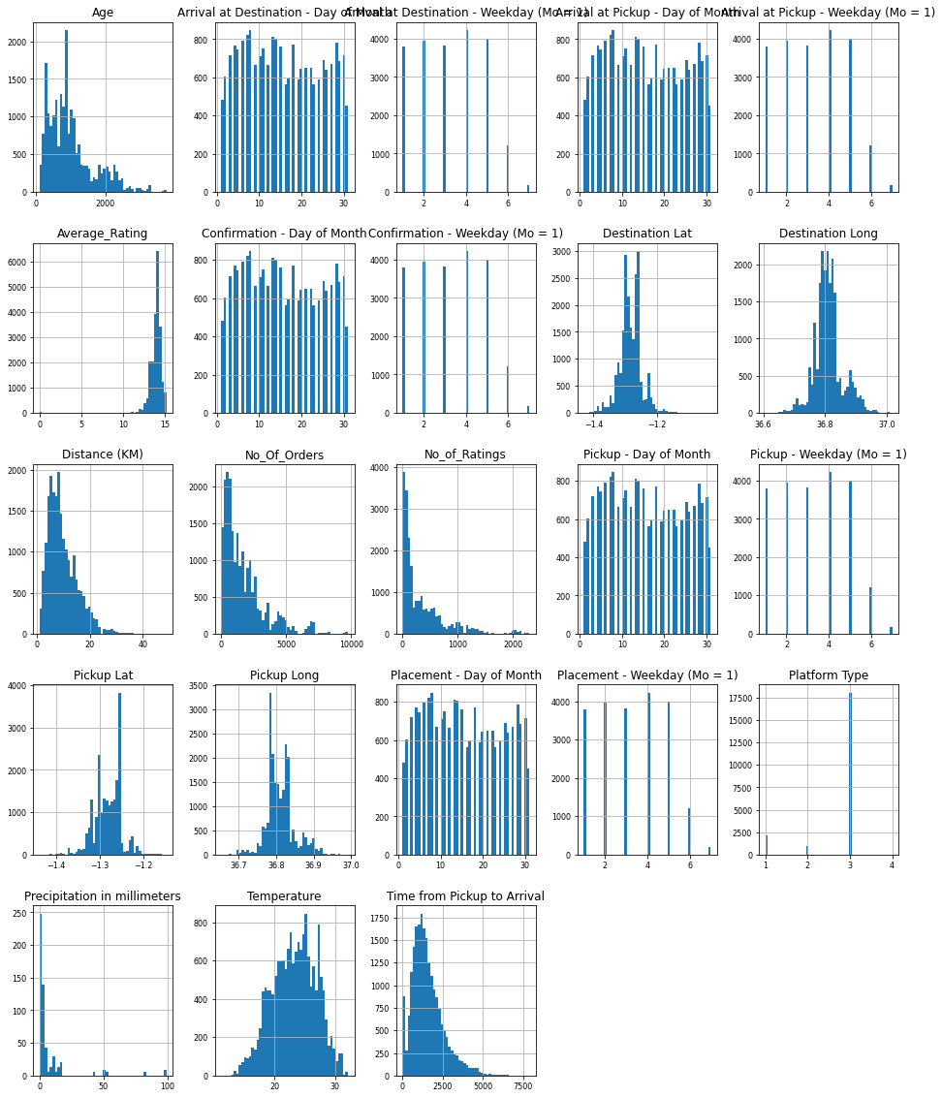
Distribution of Train Data Set

Slide 9
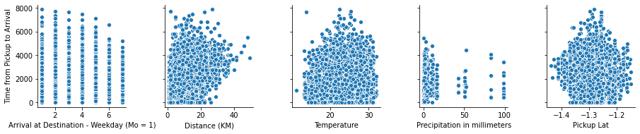
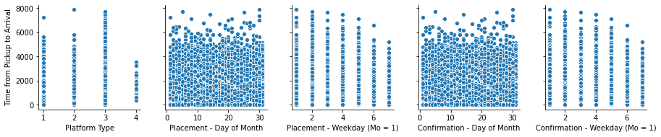
Scatter plot showing the relationship between the train dataset numerical data and the predictor variable
Notes:
Scatter plot showing the relationship between the numerical data and the predictor variable

Slide 10
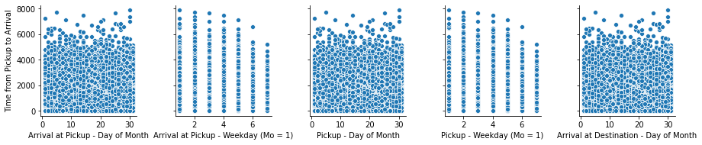
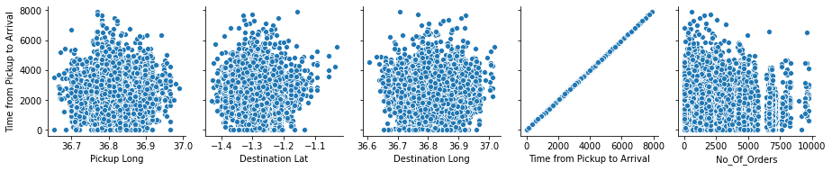
Scatter plot showing the relationship between the train dataset numerical data and the predictor variable

Slide 11
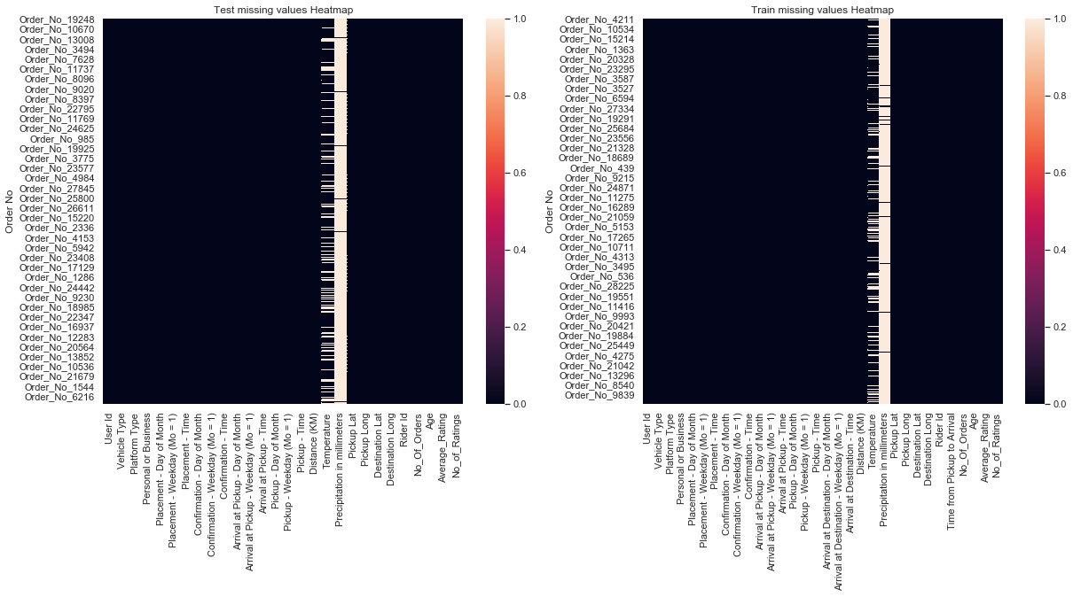
Preprocessing
Missing Values
Precipitation - 97%
Temperature - 20%

Slide 12
Preprocessing
Outliers
4% of data
The Box Plots for different features:

Slide 13
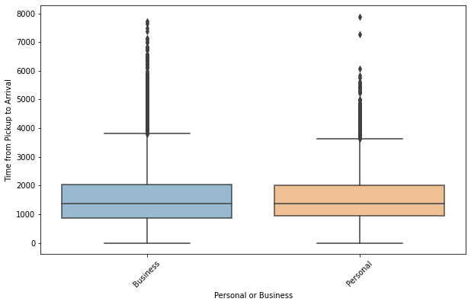
Preprocessing
Outliers
Personal or Business Feature

Slide 14
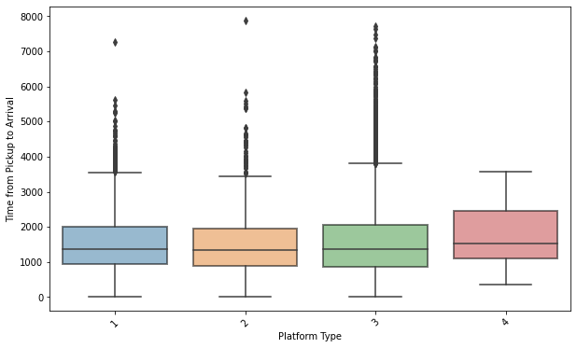
Preprocessing
Outliers
Platform

Slide 15
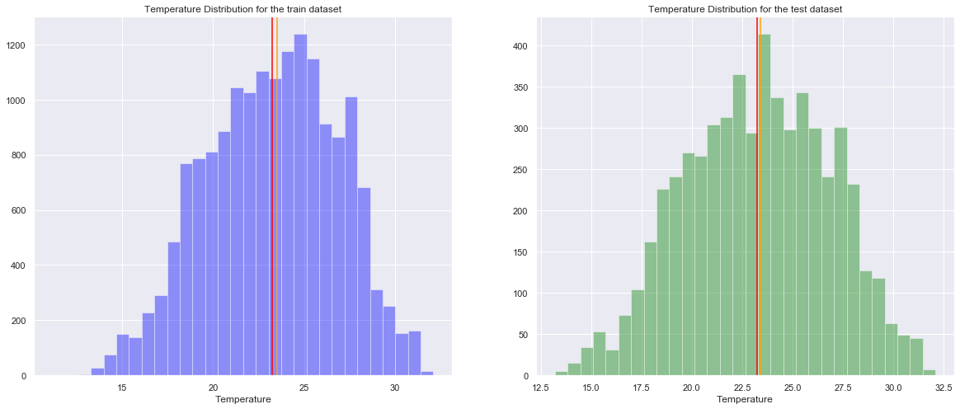
Preprocessing
Imputation
Temperature is normally distributed in both train and test datasets.
We fill the missing values in both datasets with mean.

Slide 16
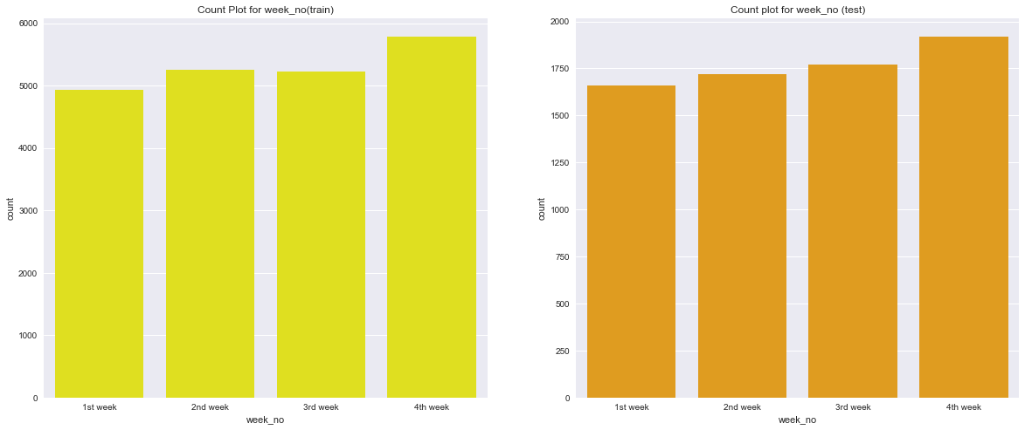
Feature Engineering
Time Features
Placement - Day of Month to Week of the Month (ie 1st week etc)

Slide 17
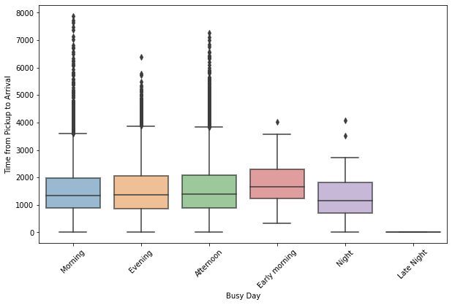
Feature Engineering
Time Features
Placement - Time to off peak and on peak (ie 1st week etc)

Slide 18
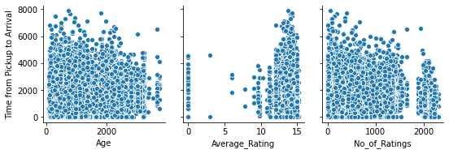
Scatter plot showing the relationship between the rider dataset numerical data and the predictor variable

Slide 19
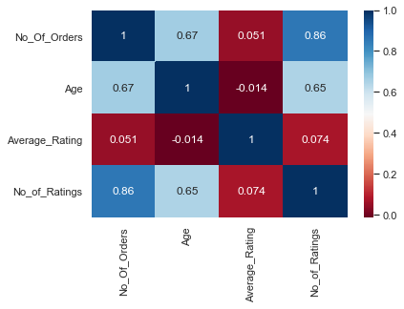
Feature Engineering
Riders Features Heatmap
Create new meaningful features :
Delivery Rate
Scaled Rating

Slide 20
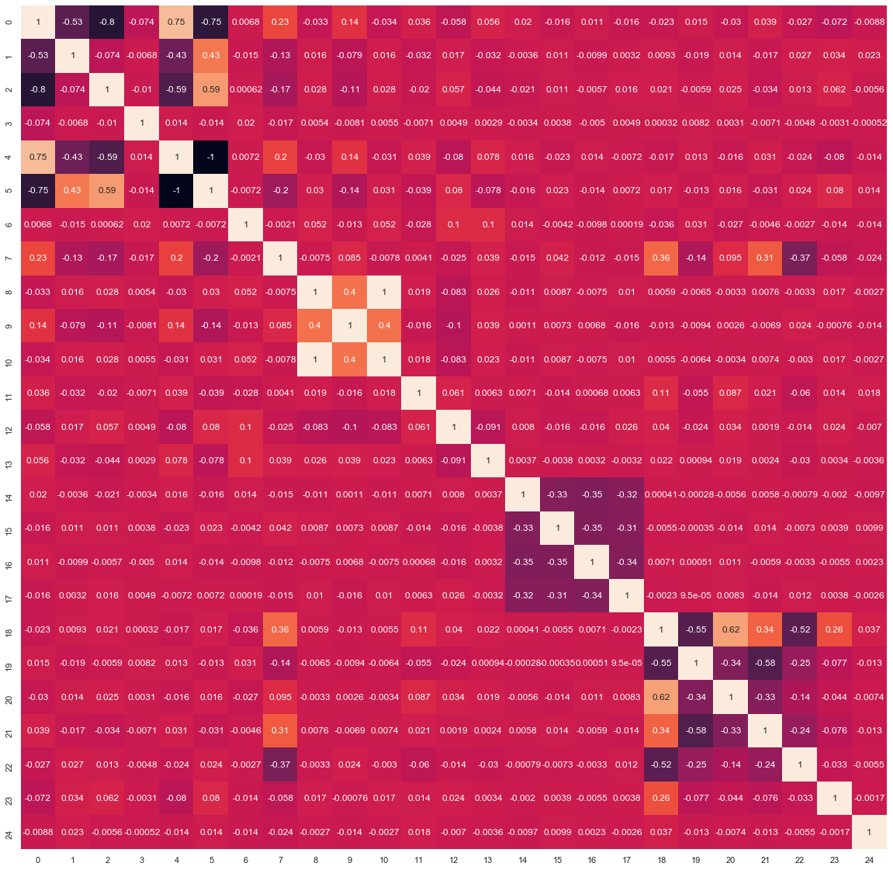
Feature Engineering
Train data set after Feature Engineering

Slide 21
Checking Significant Correlation
between numerical data
Distance (KM) 0.580608
Notes:
We find that Distance is the highest correlated column, in the dataframe, to the target variable

Slide 22
Fitting The Model
Multiple Linear Regression
After normalizing the entire Dataframe we decided to start with the multiple Linear regression model.
Root Mean Square Error(RMSE): 796.403362847875

Slide 23
Fitting The Model
Random Forest
RMSE: 858.881702264492
Ridge Regression
RMSE : 795.7397792993
Lasso Regression
RMSE: 795.7397792993

Slide 24
Fitting The Model
After building all the models we decided to try and ensemble them to get a better rmse score
Ensemble Model
RMSE: 793.848121940663

Slide 25
Conclusion
Thank You !!!

